Slide 1
Boeng 737 Scandal
Student’s Name
Institution

Slide 2
Synopsis
2019 was a bad year for Boeng
Two planes crashed killing hundreds
Boeng 737 leaving Jakarta crashed in October
In March, another Boeng 737 crashed in Ethiopia
The causes of the tow have been linked to software problems
But, it showed corporate social irresponsibility
Big planes had proven to be a problem
The company decided to go bigger anyway
Notes:
Boeng 737 crashes in 2019 was one of the deadliest aircraft accidents in the aviation industry, and yet the company has maintained that they were caused by software update problems. However, the incidences in 2019 have proven that even big companies like Boeng are lacking proper business policy and strategy to help manage and control disasters like this from happening. Despite bigger planes proving to be a problem, Boeng decided to continue with the production of big planes, which have raised not only legal questions but also ethical questions.

Slide 3
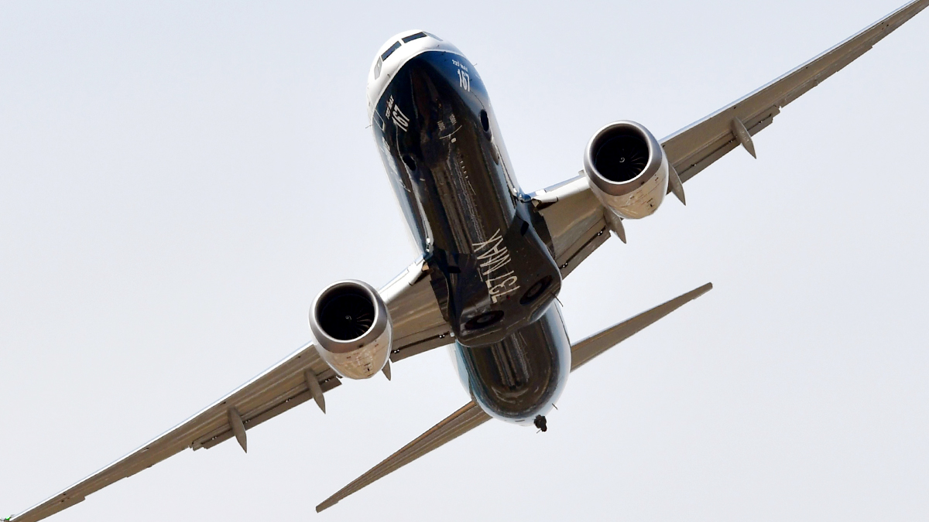
Unethical Behaviors
Several factors have been attributed to the crash
The company claims software hitches
Investigations identified serious unethical behavior
Failures were not caused by a single thing
Pressure to update the designs
Faulty assumptions
Corruption
Inherent conflict of interests
Culture concealment (Levin, 2020)
Notes:
The two crashes that left hundreds of people dead in Indonesia and Ethiopia has been attributed to several factors. In a 245-page document report given by the congressional investigations, Boeng contributed in the failure and faulty issues that caused the accidents in many ways. The above five reasons were identified as the main causes of the crashes, which was mainly part of the company. Its unethical conduct including engaging in corruption by bribing the top FAA managers for the approval of the evaluation programs. The company failed in many ways and the cost was the lives of hundreds of travellers who were traveling from different parts of the country to their destinations.

Slide 4
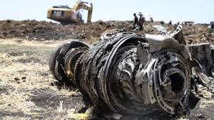
Costs Associated with this Strategy
Several lessons have been learned
For the company,
Such unethical behaviors resulted in:
Series of losses from the 3-day grounded period (Levin, 2020)
Legal repercussions
Financial burden in compensating victims
Reduced customers
For the customers, the cost was lives lost
Notes:
The cost of doing business under such unethical conducts have been very evident in the way Boeng operated after the two crashes. After the investigation showed that the company was solely responsible for the damages and events that resulted in the death of hundreds of passengers, the company was grounded for three days. One can only estimate the losses incurred during the three day period for a multibillion corporation like Boeng. However, that was not the end. Other costs associated with such behaviors include legal battles, which is still continuing, declining customers, and financial burden associated with compensation of victims’ families and relatives. However, the cost for customers cannot be imagined as it was the loss of lives.

Slide 5
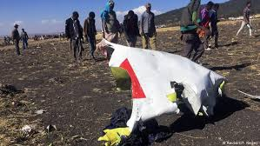
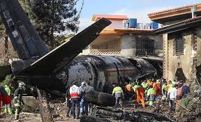
Managers and Leaders
Managers and leaders have a responsibility including:
Compliance with the FAA regulations
Thoroughly evaluating the design
Embracing transparency
Being accountable for the activities
Considering the safety of customers first
Being responsible leaders
Notes:
Being a responsible leader means that one does not engage in activities that could compromise the company’s reputation or put the customers in danger. As the report of investigation showed, the failures in Boeng were majorly on the company leaders and managers who failed to do their job. There was lack of accountability, transparency in the design process, and inability to consider the safety of customers before the interests of the managers and the shareholders who are meant to benefit when the company make huge profits. Implementing the above should have helped to prevent the crashes.

Slide 6
Policies and Strategic Decisions
1. Building a corporate culture that supports honesty
False assumptions made fundamental risks
2. Crisis management plan
3. Transparent in its operations
The scandal highlighted culture concealment
The company concealed critical information from the regulator, FAA
Key stakeholders were not informed
Notes:
Success of the organization to manage and control risks like the one that Boeng experienced in 2019 is largely based on its relationship with the key stakeholders (customers, government, and employees). However, as the investigation report showed, the company was involved in more than one unethical conduct. Ranging from concealment of crucial information to bribing the FAA officials to gain control in the market. This is greed and does not reflect goodwill of the free market. Boeng could have avoided the scandal through above policy and strategic decisions. Building a corporate culture on trust and honesty is fundamental because it would have ensured that the company was acting in the best interest of customers who use the planes. The scandal also highlighted lack of transparency in its operations as engineers were pressured to work on the designs before it be evaluated to determine its safety.

Slide 7
Decision-Making
Decentralized decision-making could have helped
Unlike centralized system, decentralized decision-making rely on teams
Boeng has a centralized culture
This means that the management makes all the decisions
This informs the pressure on engineers to work on 737 design
Engineers would have autonomy to make choices
Notes:
Decision-making is critical in every organization because it sets how the organization runs its operations. However, the way decisions are made can also affect the organization’s activities. In the case of Boeng, a decentralized decision-making could have helped prevent such scandal. Unlike the current centralized system where the management has all the autonomy to make every decision that impacts the organization, decentralized decision-making would have ensured that the engineers who worked on 737 design had the autonomy to make the decisions that they need to ensure that the safety concerns were considered before the design is released to the market. Engineers were pressured to work on the design, which contributed significantly to the failure of the plane.

Slide 8
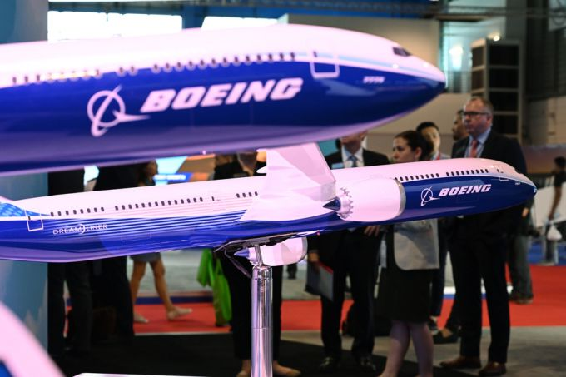
Business Policies
1. Develop an ethical standard
-Formalize the expectations
-Make it clear what behaviors are acceptable
-Create a code of ethics section
2. Promote Community Involvement
-Shows genuine interest in creating a positive impact
3. Promote monitoring and accountability
4. Training and reinforcement
Notes:
Business policies that can help prevent such scandals from happening have been highlighted above. These policies ensure that the organization fulfills its corporate social responsibility to protecting the customers and the environment. For example, monitoring and accountability policy will ensure that the organization undertakes the due diligence before rolling any product in the market. This will, in turn, prevent accidents like the Boeng’s accidents from happening while also advancing protection of the environment. Regular training and reinforcement policy will ensure that the engineers and other employees and top management are equipped with the corporate social responsibility skills to help them understand their role as individual and team to contribute in making the organization achieve its goals.

Slide 9
Conclusion
Boeng 737 accidents in 2016 was disastrous
But, they served as example to many companies
The accidents pointed out:
Importance of corporate strategy that values customers
Importance of decentralized decision-making
The role of organizations in CSR management
Boeng failed in CSR due to its unethical conducts
Other companies should learn from this
Notes:
As I conclude this presentation, I would like to reiterate that Boeng 737 failure was not caused by a single factor as the company anticipated and reported before. After investigations were conducted, it became clear that corporate leadership irresponsibility and selfishness was a major concern that would have been avoided. Boeng have served as an example to what bad leadership means to business organizations. As such, companies, both small and big, should take the important lesson from this case and make better business policies and strategic decisions that can impact the community, the business, and the customers positively.

Slide 10
Reference
Levin, A. (2020, September 16). “Sweeping Failures and Insufficient oversight led to Boeng 737 Max Crashes, Scathing house report finds.” Time. Retrieved from https://time.com/5889376/boeing-737-max-house-report/

